Slide 1
The Adjustment of Hyperparameters and Model Architecture in Prediction Model of OVF Collapse Progression
Sibeen Kim

Slide 2
Short Bio
B.S. in Biomedical Engineering, Korea University
Research Intern @ *LANIB, Severance Hospital
Research Intern @ Letsur
Research Intern @ **BREIN Lab, Korea University
Mar 2018 - Present
Apr 2023 - Present
Jan 2024 - Present
Feb 2024 - Present
* Laboratory of Advanced Neuroimaging Biomarker research
** Brain Reverse Engineering by Intelligent Neuroimaging

Slide 3
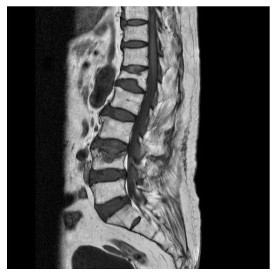
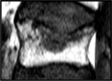
Osteoporotic Vertebral Compression Fracture
Vertebral Collapse
7-37%
Notes:
여기가 문제에요

Slide 4
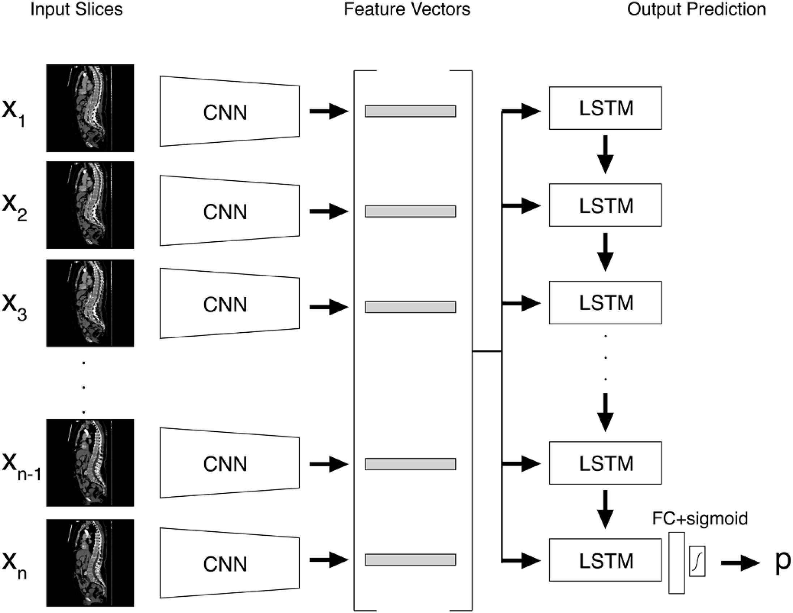
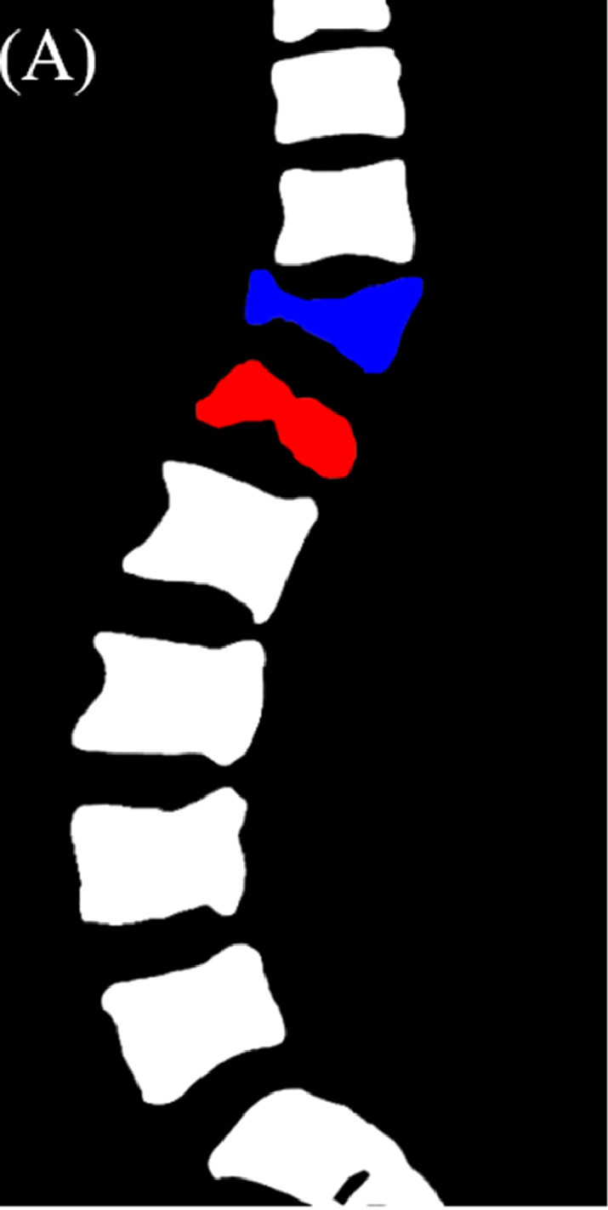
CNN for OVF Diagnosis
Old
vs.
Fresh

Slide 5
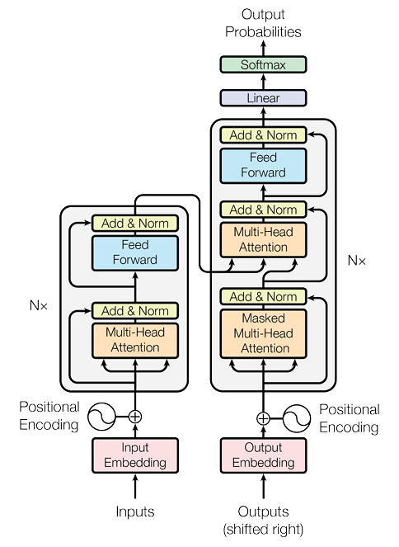
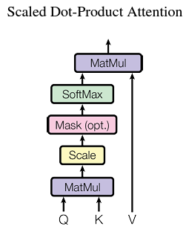
Transformer

Slide 6
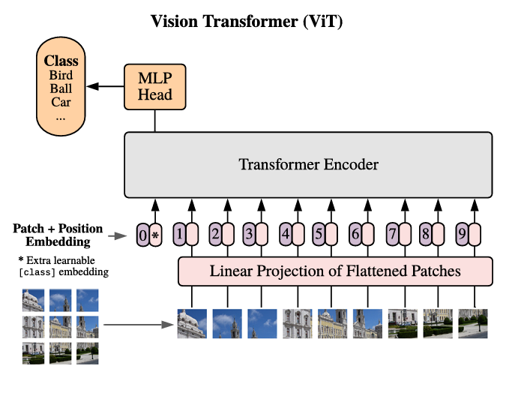
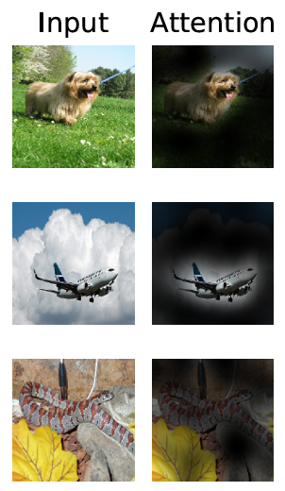
Vision Transformer

Slide 7
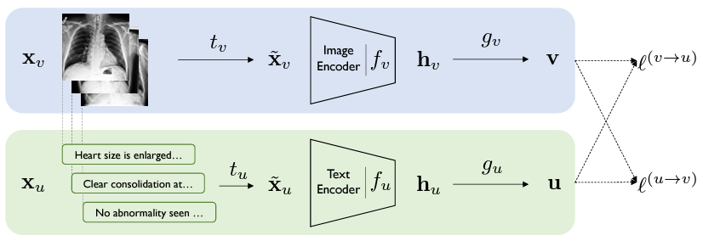
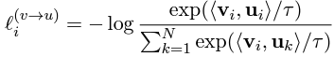
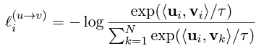
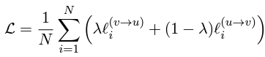
Contrastive Visual Representation Learning from Text

Slide 8
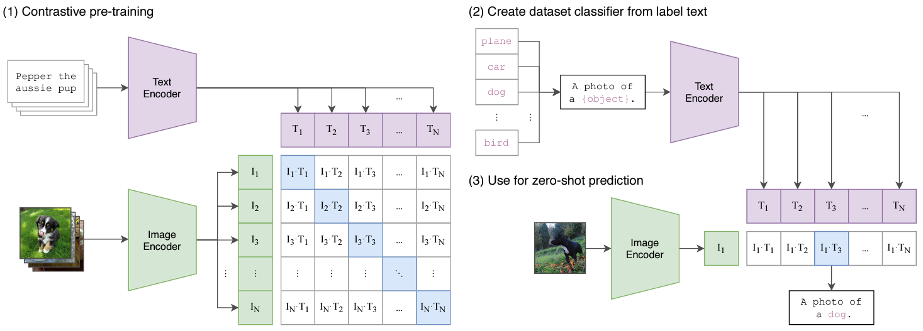
CLIP
e.g. ViT

Slide 9
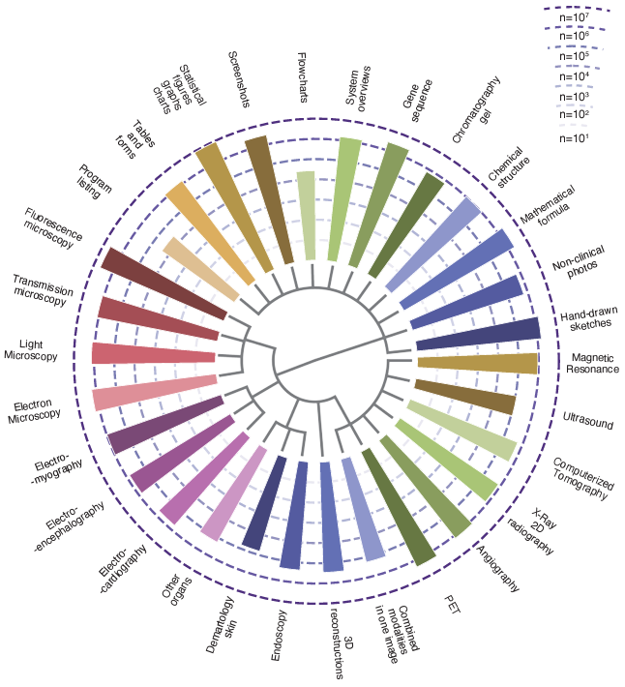
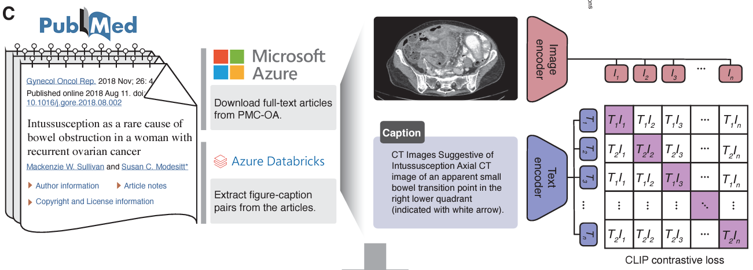
BiomedCLIP

Slide 10
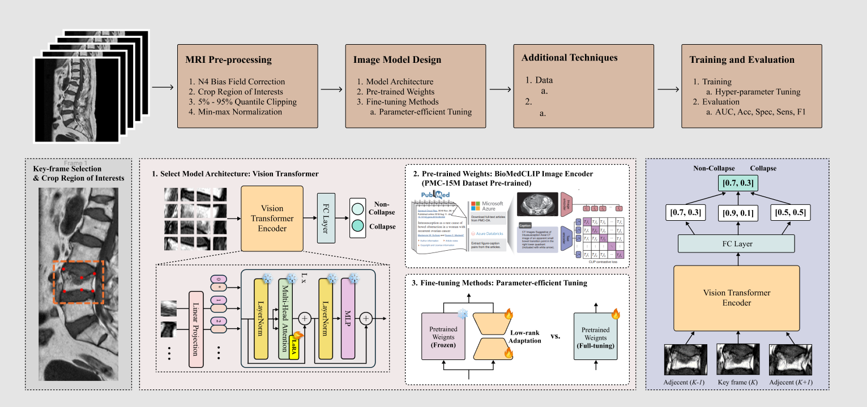

MRI Preprocessing
1. N4 Bias Field Correction
2. Crop Region of Interests
3. 5%-95% Quantile Clipping
4. Min-max Normalization
Image Model Design
1. Model Architecture
2. Pre-trained Weights
3. Fine-tuning Methods
a. Parameter-efficient Tuning
Ensemble Prediction
1) Data-level: 1 key+2 adjacent slices
2) Probability average ensemble
Training and Evaluation
1. Training
a. Hyper-parameter Tuning
2. Evaluation
a. AUC, Acc, Spec, Sens, F1

Slide 11
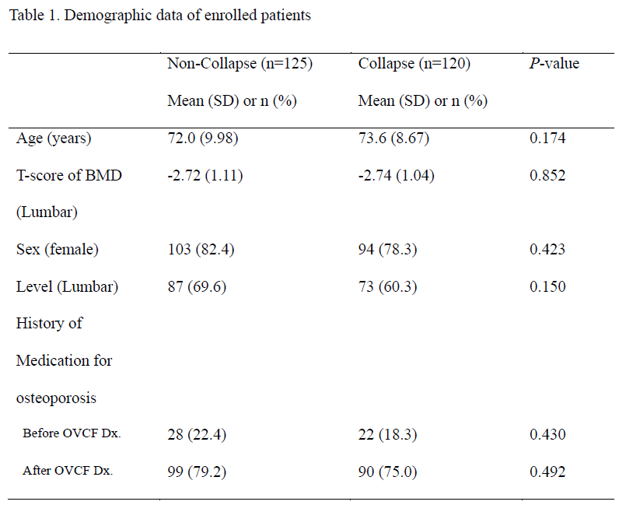
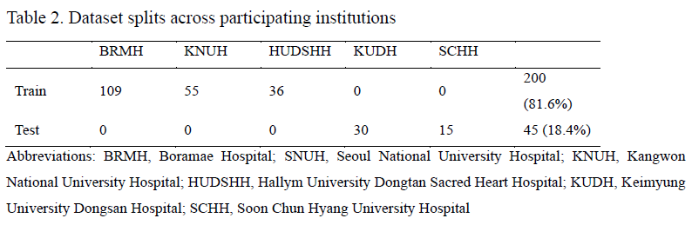
Demography
Notes:
넣고 이런데이터로 참여했습니다.

Slide 12
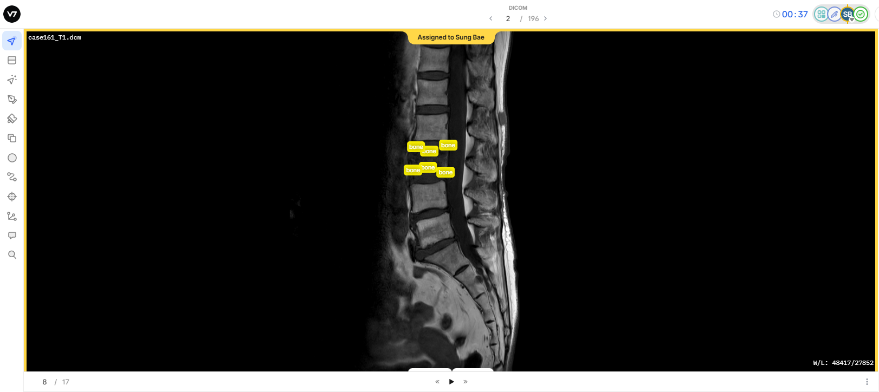
Preprocessing

Slide 13
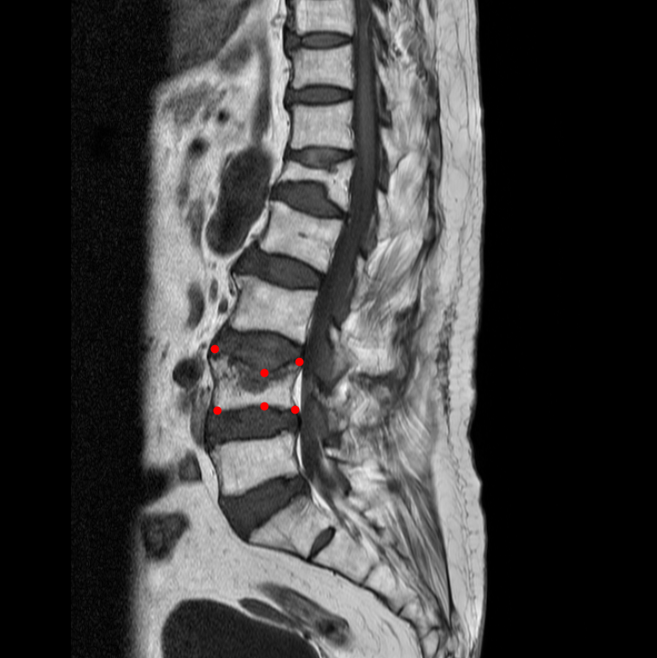
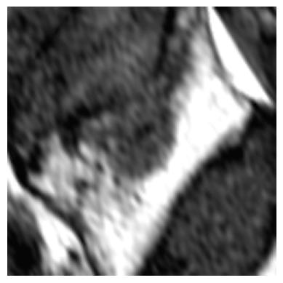
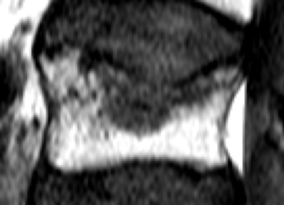
Preprocessing
p
p
Linear
Linear
512 features
768 features
CNN
ViT
Keypoint
Labeling
Data
Augmentation
150% Expanded ROI Crop

Slide 14
Model Design: Pretrained Weights
 | Internal Validation |  |  | External Validation
 | AUC | Spec | Sens | AUC | Spec | Sens
CNN scratch | 0.7830 | 0.7844 | 0.6699 | 0.7097 | 0.6963 | 0.6611
CNN ImageNet | 0.7973 | 0.7833 | 0.7123 | 0.8014 | 0.7074 | 0.7833

Slide 15
Model Design: Pretrained Weights
 | Internal Validation |  |  | External Validation
 | AUC | Spec | Sens | AUC | Spec | Sens
ViT Scratch | 0.8159 | 0.7996 | 0.7086 | 0.7979 | 0.7630 | 0.6944
ViT ImageNet | 0.8185 | 0.8642 | 0.6517 | 0.7825 | 0.7333 | 0.7333
ViT PMC | 0.8269 | 0.8057 | 0.7306 | 0.8051 | 0.7296 | 0.7556

Slide 16

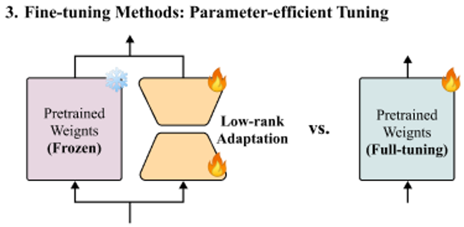

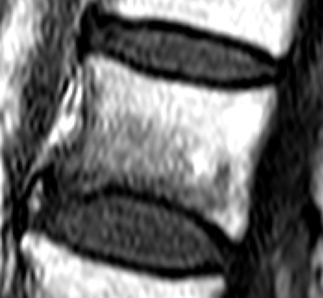


Model Design: Fine-tuning Methods
+
MLP
Non-Collapse / Collapse
LayerNorm
Linear
L x
+
LoRA
Multi-Head Attention
Vision
Transformer
LayerNorm
0
*
1
2
$$⋯$$
Linear Projection
$$⋯$$

Slide 17
Model Design: Fine-tuning Methods
 | Internal Validation |  |  | External Validation
 | AUC | Spec | Sens | AUC | Spec | Sens
ViT PMC | 0.8269 | 0.8057 | 0.7306 | 0.8051 | 0.7296 | 0.7556
ViT PMC LoRA | 0.8404 | 0.8557 | 0.7012 | 0.8113 | 0.6963 | 0.8111

Slide 18
Model Design: Architecture
 | # Trainable | Internal Validation |  |  | External Validation
 | Parameters | AUC | Spec | Sens | AUC | Spec | Sens
CNN ImageNet | 11.2 M | 0.7973 | 0.7833 | 0.7123 | 0.8014 | 0.7074 | 0.7833
ViT PMC LoRA | 0.886 M | 0.8404 | 0.8557 | 0.7012 | 0.8113 | 0.6963 | 0.8111

Slide 19
Additional Technique
 | Internal Validation
 | AUC | Spec | Sens
ViT PMC LoRA | 0.8404 | 0.8557 | 0.7012
ViT PMC LoRA + ensemble | 0.8539 | 0.8230 | 0.7739
 | External Validation
 | AUC | Spec | Sens
ViT PMC LoRA | 0.8113 | 0.6963 | 0.8111
ViT PMC LoRA + ensemble | 0.8656 | 0.8111 | 0.7611

Slide 20
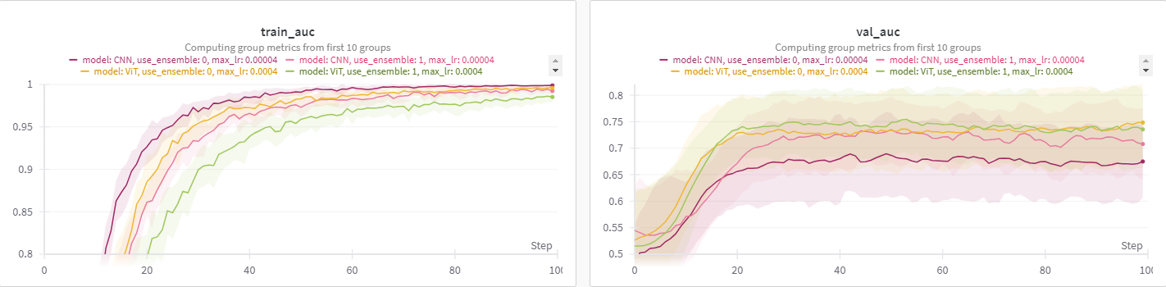
Hyperparameter Tuning

Slide 21
Hyperparameter Tuning
(1) Short epoch + Broad range fixed learning rate
Objective: Identify “possible” range (underfitting X, overfitting X)
(2) Longer epoch + Narrow range fixed learning rate + Other h.p. tune
e.g. weight decay, batch size, lora_rank
Objective: Stabilize training… Find good candidates!
(3) Scheduler selection + Scheduler h.p. tune (e.g. warmup)
Objective: Find best setting!
(4) Excessive epoch + early stop + seed
Objective: Find best score!

Slide 22
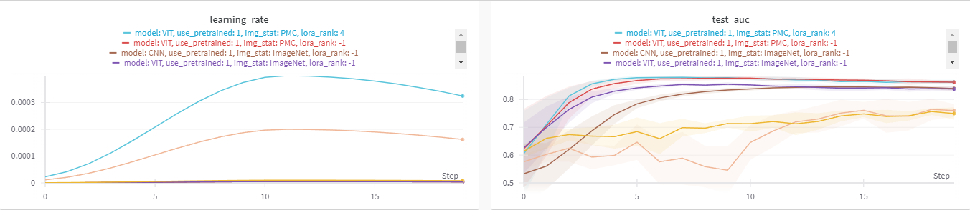
Hyperparameter Tuning

Slide 23
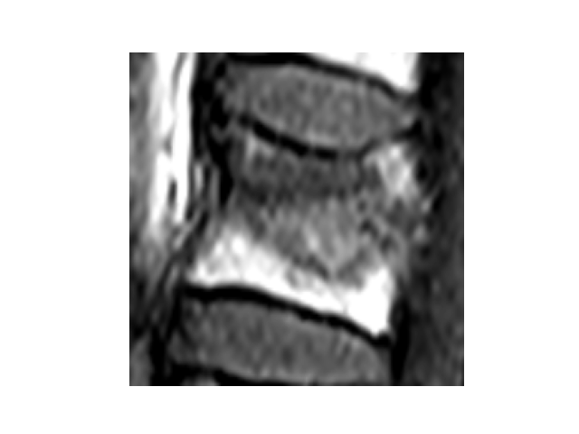
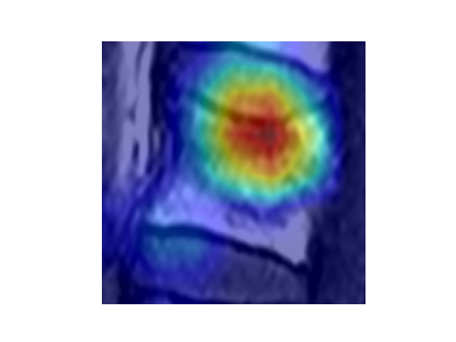
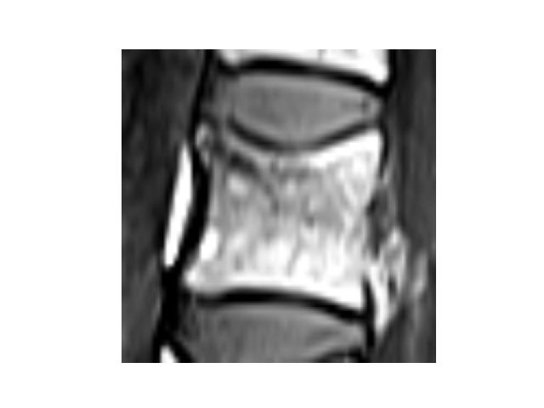
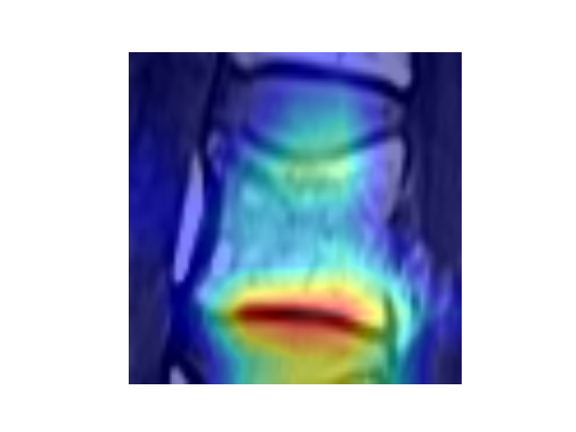
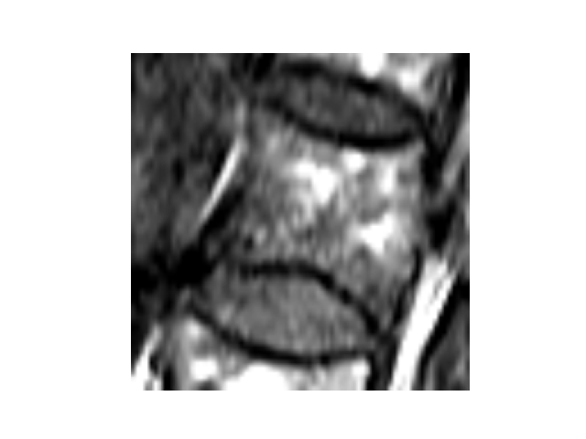
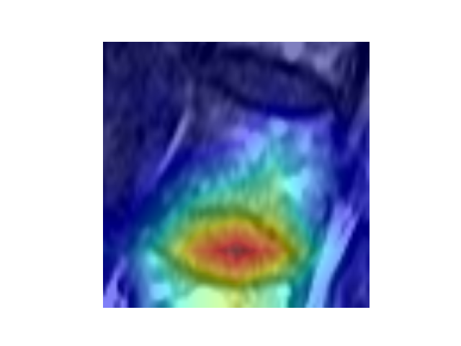
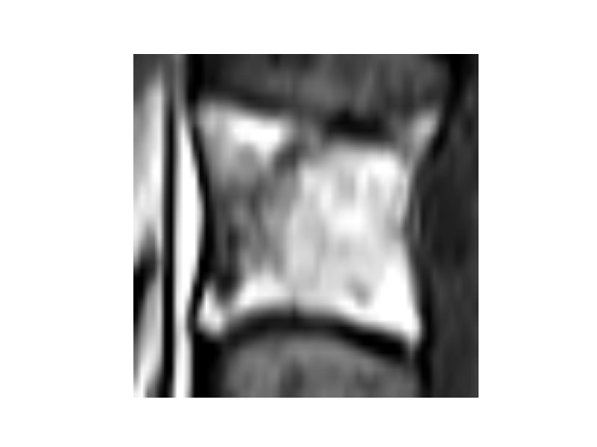
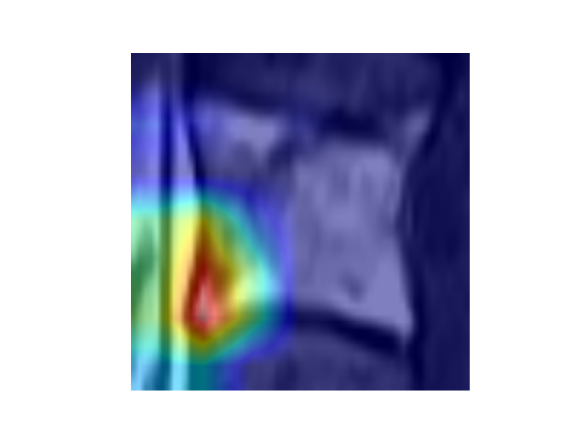
Grad-CAM
TP
TN
FP
FN

Slide 24
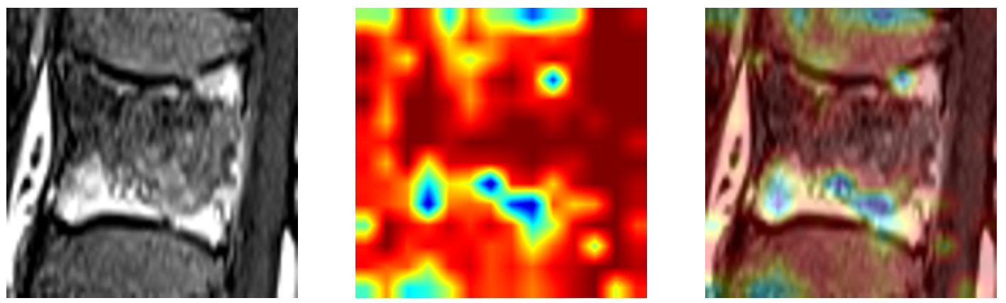
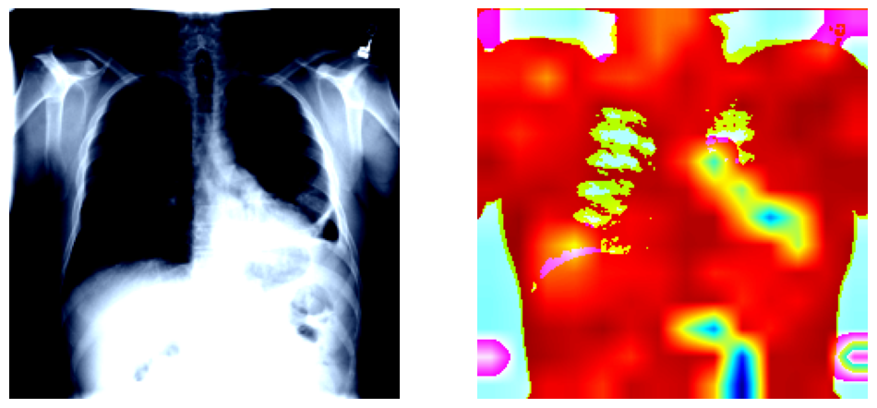
Attention Rollout

Slide 25
Key Results
 | # Trainable | Internal Validation |  |  | External Validation
 | Parameters | AUC | Spec | Sens | AUC | Spec | Sens
CNN ImageNet | 11.2 M | 0.7973 | 0.7833 | 0.7123 | 0.8014 | 0.7074 | 0.7833
ViT PMC LoRA | 0.886 M | 0.8404 | 0.8557 | 0.7012 | 0.8113 | 0.6963 | 0.8111
 | Internal Validation |  |  | External Validation
 | AUC | Spec | Sens | AUC | Spec | Sens
ViT PMC LoRA | 0.8404 | 0.8557 | 0.7012 | 0.8113 | 0.6963 | 0.8111
ViT PMC LoRA + ensemble | 0.8539 | 0.8230 | 0.7739 | 0.8656 | 0.8111 | 0.7611

Slide 26
Reference
Yabu, A. et al. Using artificial intelligence to diagnose fresh osteoporotic vertebral fractures on magnetic resonance images. Spine J 21, 1652-1658, doi:10.1016/j.spinee.2021.03.006 (2021).
Tomita, N., Cheung, Y. Y. & Hassanpour, S. Deep neural networks for automatic detection of osteoporotic vertebral fractures on CT scans. Comput Biol Med 98, 8-15, doi:10.1016/j.compbiomed.2018.05.011 (2018).
Ashish Vaswani, Noam Shazeer, Niki Parmar, Jakob Uszkoreit, Llion Jones, Aidan N Gomez, Lukasz Kaiser, and Illia Polosukhin. Attention is all you need. NeurIPS, 2017.
Dosovitskiy, A. et al. An image is worth 16x16 words: transformers for image recognition at scale. In International Conference on Learning Representations (ICLR, 2021).
Zhang, Y., Jiang, H., Miura, Y., Manning, C. D. & Langlotz, C. P. Contrastive learning of medical visual representations from paired images and text. In Machine Learning for Healthcare Conference (eds Lipton, Z. et al.) 2–25 (PMLR, 2022).
Alec Radford, Jong Wook Kim, Chris Hallacy, Aditya Ramesh, Gabriel Goh, Sandhini Agarwal, Girish Sastry, Amanda Askell, Pamela Mishkin, Jack Clark, Gretchen Krueger, and Ilya Sutskever. 2021. Learning transferable visual models from natural language supervision. In International Conference on Machine Learning.
E. J. Hu, Y. Shen, P. Wallis, Z. Allen-Zhu, Y. Li, S. Wang, L. Wang, and W. Chen. Lora: Low-rank adaptation of large language models. arXiv preprint arXiv:2106.09685, 2021.

Slide 27
Thank You!

